Slide 1
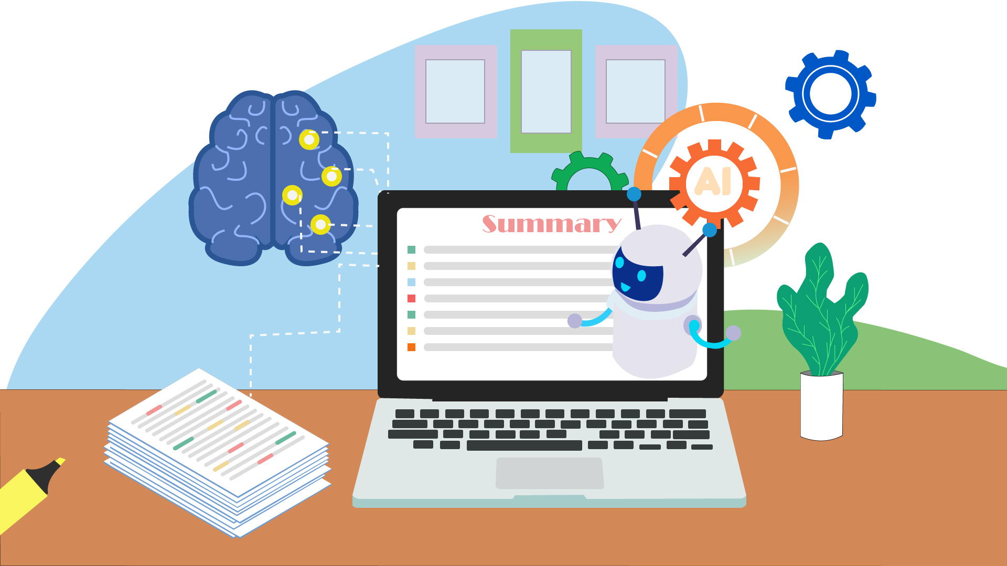




Senior Design
Autonote: Transformative Meeting Summarization and
Highlighting Points Based on NLP
Group Members
Sheikh Mohammed Wali Ullah
2021186042
Md Saiyem Raiyan
2012468042
Samia Sultana
2014048042
Zobaer Ahammod Zamil
2021796042

Slide 2
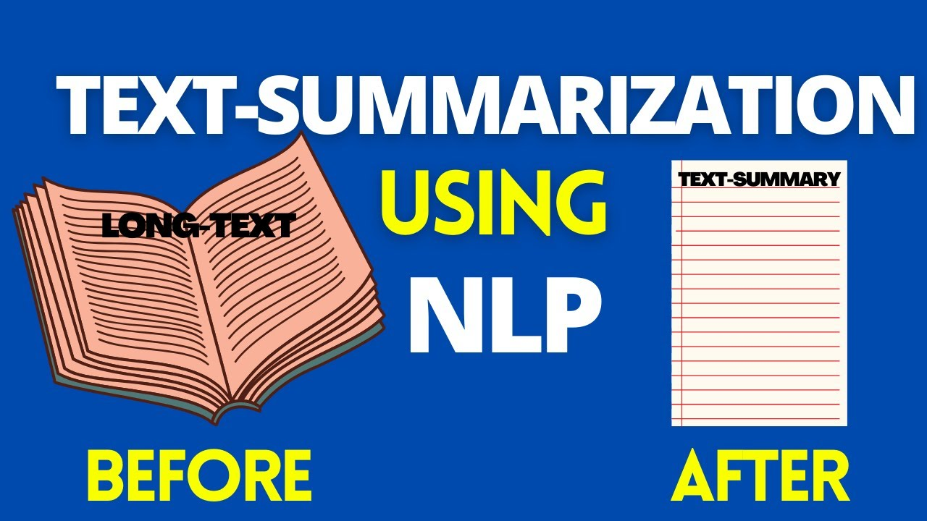
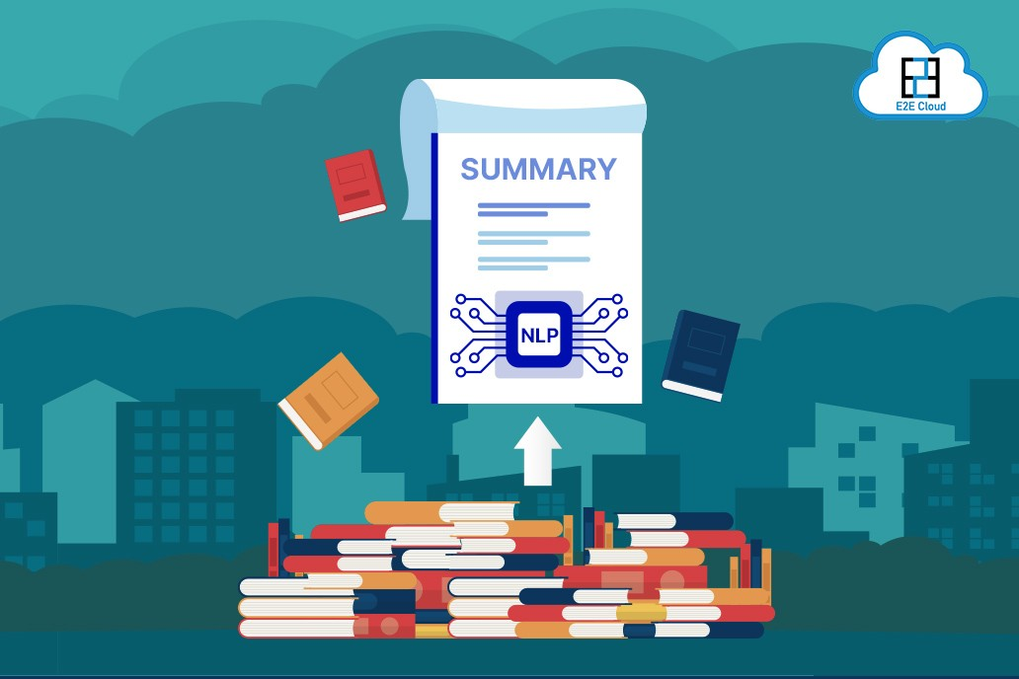
What is Summarization?
The process of condensing a longer piece of text, such as an article, book, or document, into a shorter version while retaining its essential information, main points, and key ideas. The goal of summarization is to provide a concise and coherent representation of the original text's content, making it easier for readers to quickly grasp the main concepts without having to read the entire source material.
Extractive Summarization
Selects and extracts sentences or phrases directly from the source text to create the summary. It does not generate new sentences but rather identifies the most relevant, informative portions of the original text. Extractive summarization is generally more straightforward but may not always produce as fluent summaries as abstractive methods.
Contents Here
Contents Here
A
E
Abstractive Summarization
In abstractive summarization, the summarizer generates a summary in its own words, often rephrasing and restructuring sentences to create a coherent and concise summary. This approach requires natural language understanding and generation capabilities, making it more challenging but capable of producing human-like summaries.

Slide 3
What is Natural Language Processing (NLP)?
N
NLP stands for Natural Language Processing. It is a field of artificial intelligence (AI) that focuses on the interaction between computers and human language. NLP involves the development of algorithms, models, and techniques that enable computers to understand, interpret, and generate human language in a way that is both meaningful and useful.
L
P
Text Classifications
Text Extraction
Machine Translation
Natural Language Generation
Text Classifications
Text Extraction
Machine Translation
Natural Language Generation
Process of categorizing textual data into predefined classes or categories, enabling automated sorting, filtering, or labeling of text documents based on their content, such as sentiment analysis, spam detection, or topic categorization.
Identifying and extracting specific pieces of information, such as names, dates, or entities, from unstructured text data, allowing structured data to be derived from text documents, which is valuable for various applications like information retrieval and data analysis
Automatic process of translating text or speech from one language to another using algorithms and models, facilitating cross-lingual communication and information access. Prominent approaches include Neural Machine Translation (NMT) and statistical methods.
Technology that generates human-like text or speech from structured data, making it possible to automate content creation, chatbot responses, and personalized reports. It often leverages techniques like rule-based systems or advanced models such as GPT-3 for text generation.

Slide 4
Summarization with NLP
Size: 100% → 30%
Summarization With NLP
Summarization with Natural Language Processing (NLP) is the
use of NLP techniques to automatically generate concise summaries
from extensive textual content.
Approaches: It employs two primary methods—abstractive summarization, which generates summaries in its own words, and extractive summarization, which selects and combines sentences from the source text.
Applications: NLP-based summarization has diverse applications, including news summarization, document condensation, content recommendation, and enhancing search engine results.
Technologies: Advanced NLP models like BERT and GPT have revolutionized abstractive summarization, while extractive summarization relies on statistical methods, machine learning, and graph-based algorithms.
Benefits: It streamlines information retrieval, aids in decision-making, and saves time by providing clear and concise summaries of complex textual data, making it a valuable tool in various domains.

Slide 5


Problem Clarification
Problem
NLP
In modern workplaces, meetings are essential for collaboration and decision-making. Automatic meeting summarization, powered by Natural Language Processing (NLP), aims to address this challenge by distilling key meeting insights into concise summaries. Sometimes we miss meetings that are happening online due to some unavoidable circumstances. Again, sometimes we miss out on some important points of the meeting because of various reasons. However, before our important work or study time is very crucial so we need to do it in a faster or optimal way. That’s why we need to summarize a long meeting so that we can be able to understand easily and a faster way within our due time. Therefore, a gist of an online meeting is often very important to those who missed it or those who try to recall it. There can be a system which can make a summary of a meeting while it is running online.
What NLP doing?
System ability?
Generated Summary
Basically, this NLP summerizing develops a system that can automatically generate accurate and informative summaries of meetings.
Given a transcript of a meeting, the system should be able to identify the most important topics, extract key points, decisions, action items, discussions, and present them in a coherent and concise manner.
Introducing a revolutionary concept: a dynamic system that crafts comprehensive summaries of online meetings as they unfold. The generated summary should capture the essence of the meeting while filtering out redundant or less relevant information.

Slide 6
Flowchart with Steps
Problem Clarification
Meeting transcript Input
Making summary of the whole meeting
Data Collection
Youtube Meeting Transcripts
Collecting Model from Hugging face
Exploratory Data Analysis
Getting short summary
Handling problematic transcripts
Dataset validation
Handling irrelevant summary
Evaluation
Performance on validation and testing datasets
Deploying the model in real-world scenarios
Model Training
Finetune the model with bidirectional LSTM
Stratified k-fold cross validation
SGD, Normalization
Model Selection
Type of model: Transformer
Evaluation metric: LSA Based Measure, ROUGE Score

Slide 7
Plan Per Week
Week 1 | Project Idea
Week 2 | Project Idea
Week 3 | Project Idea
Week 4 | Research Paper Analysis
Week 5 | Analysis + Related Works
Week 6 | Analysis + Related Works
Week 7 | Analysis + Related Works
Week 8 | Project Design
Week 9 | Project Design
Week 10 | Project Design
Week 11 | Fine Tuning
Week 12 | Ethical and professional responsibility
Week 13 | Social, Environmental effects
Week 14 | Final demo
Week 15 | Final presentation
Week 16 | Final report
Responsibility and effects
Project Design
Project Idea
Analysis + Related Works

Slide 8
CONCLUSION
1
2
3
Summarize meetings and provide participants with concise and coherent summaries that capture the main discussion points, key decisions, and action items.
Autonote utilizes NLP and machine learning techniques to efficiently summarize meetings, addressing issues like manual note-taking, incomplete summaries, forgotten action items, and difficult-to-access insights.
NLP meeting summarization is a valuable tool for teams, improving productivity, decision-making, and collaboration, despite challenges, and can be integrated into organizational workflows.

Slide 9
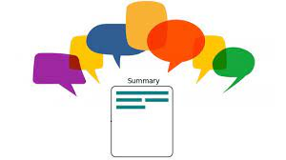
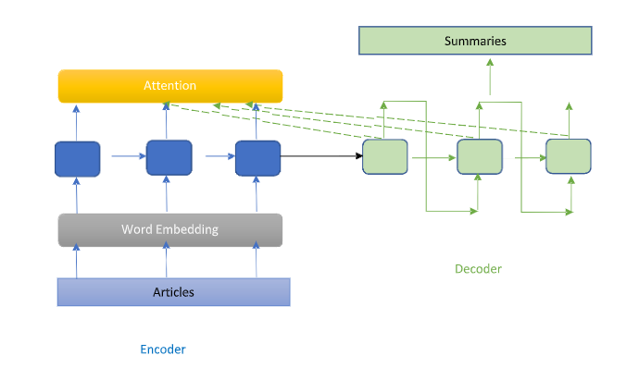
THANK YOU

